Slide 1
Reflection Portfolio for Virtual Science Labs: A Design Proposal
Sara Ringbauer
Solution to problem of designing a tool to support rural Missouri schools that lack the budget to support science learning with lab equipment.
Notes:
2ND part we will focus on design question
Rural Missouri schools don’t have the budget to support science learning that requires lab equipment. Design a tool that will support these students as they engage in science learning that typically involves lab work. Focus on learning at or above the apply cognitive level and at or above the conceptual level.

Slide 2
Design Question
Many school districts in rural Missouri do not have adequate budgets to support the science learning outcomes that require lab equipment, and experimentation. This is a problem as these skills are required learning outcomes for state and national standards.
Technology and software applications may offer a solution to this situation.
Design a technology based learning system or tool that will support students to engage in science learning that typically involves laboratory work; the learning must be at or above the “apply” cognitive level AND at or above the “conceptual” knowledge dimension level on Bloom’s revised taxonomy.

Slide 3
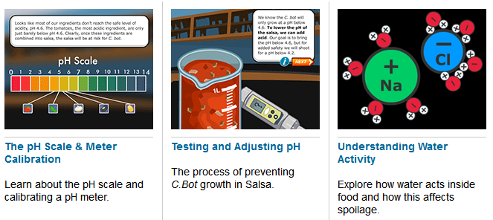
Virtual Labs
One possible low cost solution is to use virtual labs which are computer simulated labs (Ma & Nickerson, 2006).
http://virtuallabs.nmsu.edu
Notes:
One solution is for rural teachers to use virtual labs.
Many different creators, vary a lot. Typical include a step by step guide through a process.
May or may not prompt students to collect data or answer questions
Having to go back through lab sequences to find information, and recording and keeping track of data from the lab.

Slide 4
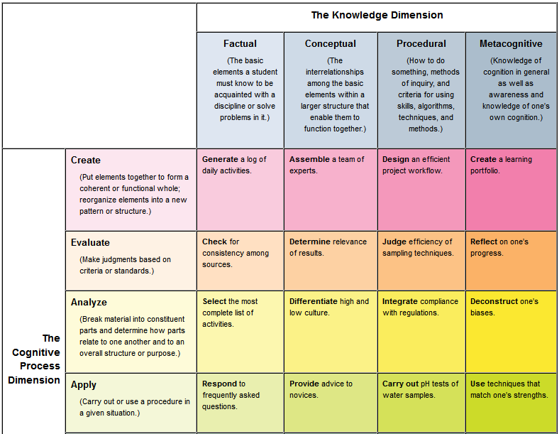
Figure 1. Revised Bloom’s Taxonomy with the Cognitive Process Dimension and the Knowledge Dimension (Heer, 2009).
Notes:
Focus on learning at or above the apply cognitive level and at or above the conceptual level of Bloom’s taxonomy.

Slide 5
Reflection
Part of metacognition in which students “deliberately thinking about a learning experience in order to improve it”.
Quintana, Zhang, and Krajcik (2005)
Woodward (1998) noted that many students find reflection difficult or fail to connect how they learned with how they can improve

Slide 6
Scaffolding with Textual Prompts
Scaffolding – provides guided instructional support to learners as they master new tasks (Wood, Bruner & Ross, 1976).
As student competency at these tasks increases, scaffolding should decrease or fade (Puntambekar & Hubscher, 2005).
Quintana Zhang, and Krajcik (2005) found improvements in student reflections by scaffolding their reflections using textual prompts.
Notes:
Feature to include in the design
Scaffolding – guided instructional support which should fade over time

Slide 7
Scaffolded Work Environment
Scaffolding metacognition by creating a scaffolded work environment that includes all the tools and features students need in one place.
Quintana, Wells, and Soloway (2002)
According to Cognitive Load Theory, this would reduce extraneous cognitive load (Paas, Renkl, & Sweller, 2003).
In this paper I use the term portfolio for scaffolded work environment.
Notes:
extraneous cognitive load, or cognition that places an unnecessary burden on working memory

Slide 8
Group Differentiation
Instructor will have the ability to create student groups e.g. 3rd period honors, 3rd 1A
Instructor can then scaffold each group differently. Some groups may get less scaffolding over time = fading.

Slide 9
Why ADDIE (Analysis, Design, Development, Implementation and Evaluation) Model?
First, ADDIE is iterative, meaning you will follow the steps through, apply modifications based on what you learn, then repeat. (Waterfall is not)
Second, with ADDIE, you try to create a product with all the features working before using the product. Agile adds new features in iterative cycles. It would not work to have a classroom intervention missing many of the features.
Finally, ADDIE is an instructional design model so it takes into account the role of the intervention in supporting instruction and in student learning outcomes (Peterson, 2003). (Waterfall and Agile do not)
Notes:
First, ADDIE is iterative, meaning you will follow the steps through, apply modifications based on what you learn, then repeat. (Waterfall is not)
Second, with ADDIE, you try to create a product with all the features working before using the product. Agile adds new features in iterative cycles. It would not work to have a classroom intervention missing many of the features.
Finally, ADDIE is an instructional design model so it takes into account the role of the intervention in supporting instruction and in student learning outcomes (Peterson, 2003). (Waterfall and Agile do not)

Slide 10
Development of Reflection Portfolio for Virtual Science Labs (RPVSL) Using the ADDIE Model
Analysis
Develop
Implement
Evaluate
Hypothesize use based on previous research on issues with higher levels of revised Bloom’s Taxonomy
Objective of supporting metacognitive reflection
Objective of making lab information easy to review
Hypothesize use based on virtual labs
Proposed solution of portfolio with scaffolded metacognitive prompts
Plan for implementation in rural high school science course with teacher using virtual labs from various sources
Rapid prtotyping
Ongoing debugging and testing of features
User Experience testing with five science education students: think alouds, tasks to complete and System Usability Scale (SUS)
Fix major functionality issues
Science teacher adds students to the RPVSL.
Instructor creates metacognitive reflection prompts for 4 virtual labs.
Train science teacher and students to use RPVSL system.
Students respond to prompts and add lab artifacts to their portfolios
Instructor creates unit metacognitive reflection prompts and students respond
Observations
Interviews
Formative assessment
Summative assessment
System logs
Student reflection responses
(normally would conduct needs assessment, task analysis and look at previous instruction which are not possible in this scenario)
Design
Data from previous iteration/s used to inform subsequent iterations
Notes:
Here is the model I used
Analysis, Design, Develop, Implement and Evaluate
What implementation would look like
First, ADDIE is iterative, meaning you will follow the steps through, apply modifications based on what you learn, then repeat. (Waterfall is not)
Second, with ADDIE, you try to create a product with all the features working before using the product. Agile adds new features in iterative cycles. It would not work to have a classroom intervention missing many of the features.
Finally, ADDIE is an instructional design model so it takes into account the role of the intervention in supporting instruction and in student learning outcomes (Peterson, 2003). (Waterfall and Agile do not)

Slide 11
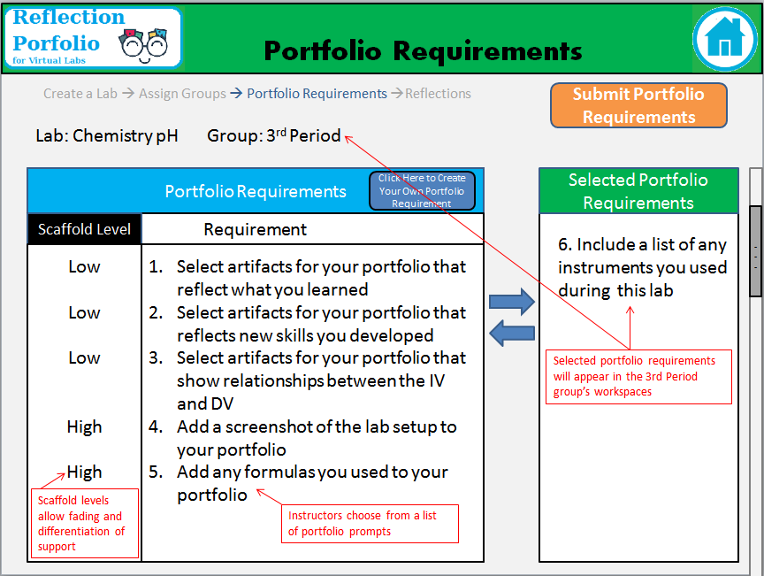
Instructor - Portfolio Requirements Single Lab
Notes:
There are two main features of this app – gathering items for the portfolio and reflecting on items in the portfolio.
Medium fidelity prototypes

Slide 12
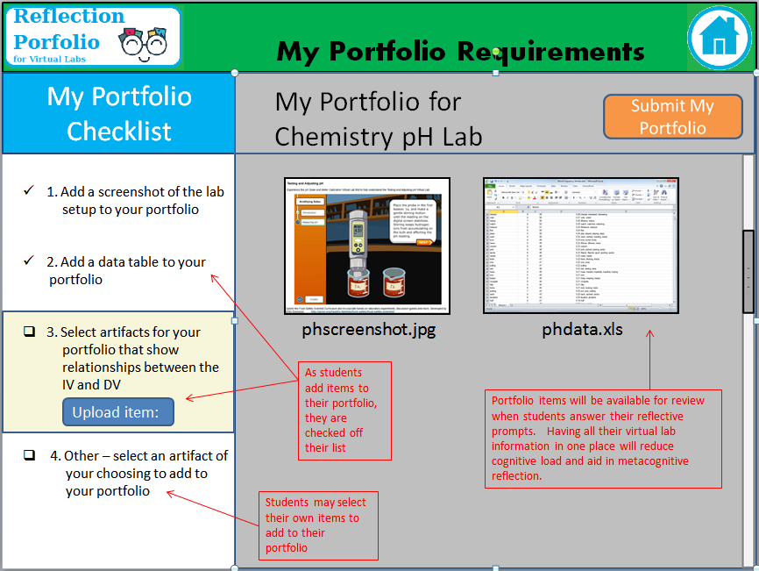
Student - Portfolio Requirements Single Lab
Notes:
Open this before using their lab. Gather information as they complete the lab.

Slide 13
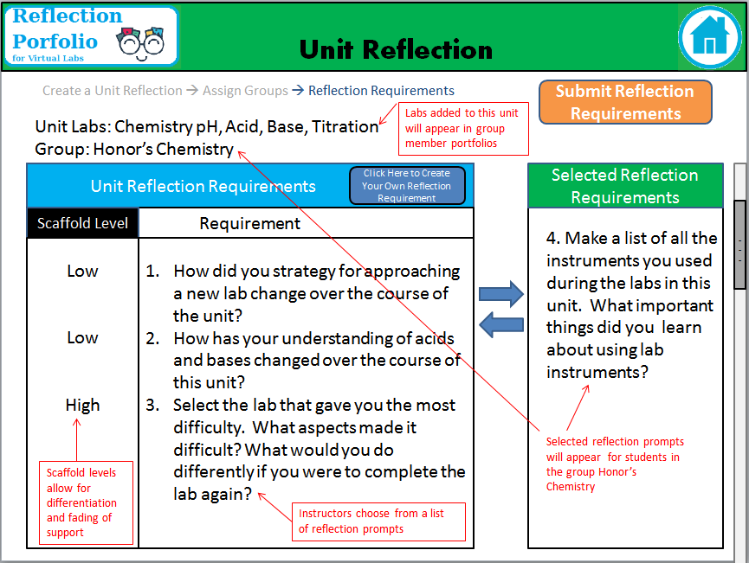
Instructor – Unit Reflection Prompts
Notes:
Look at box selection

Slide 14
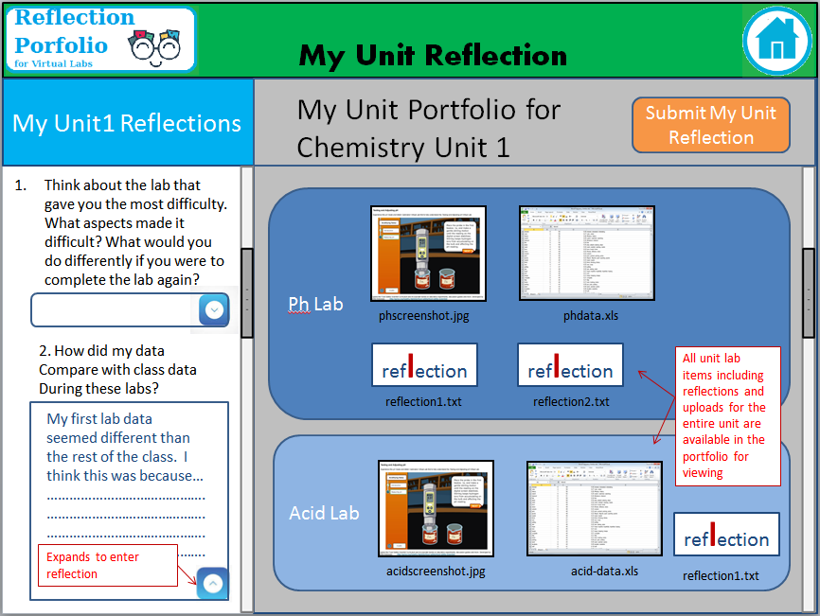
Student – Unit Reflection Prompts

Slide 15
Limitations
Relies on the instructor to pick labs, materials for the portfolio and prompts. Having a queue of prompts will help with this.
This could be expensive to create. Would need a general grant or state funding since schools are on a limited budget.
Works best on tablet or larger screen to display both prompts and portfolio space. A smaller screen smartphone would loose this advantage.

